Slide 1
Evaluation of In-Vehicle Noise for 2-Magnet Step-Skewed Rotor

Slide 2
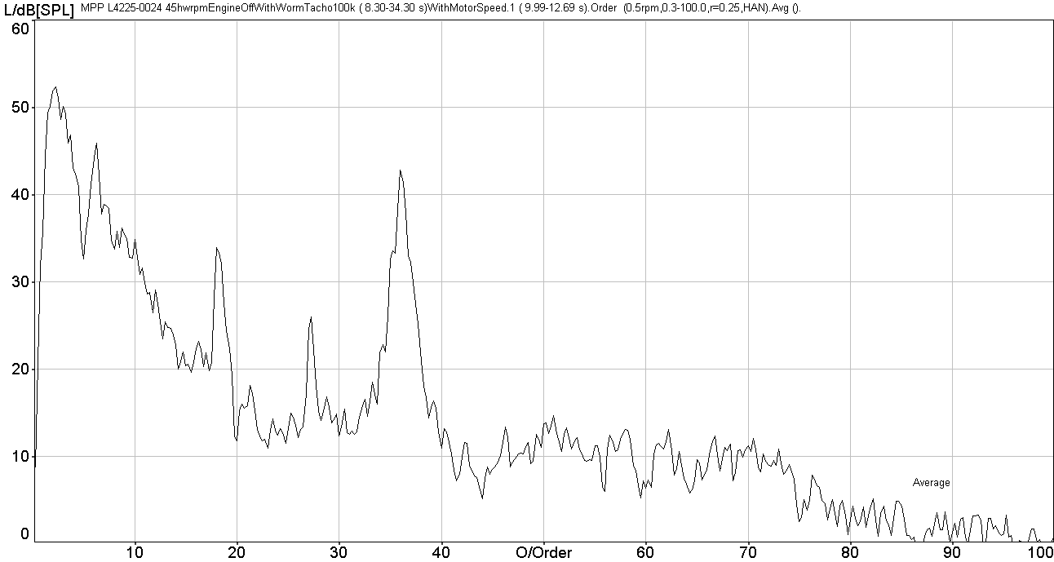
2 Step Skew Motor Noise
  Magnitude of Noise Issue
    Data Based on Opel Corsa BEV System
Sound Pressure Level, Average of Passenger Left & Right Ear, dB(A)

Slide 5
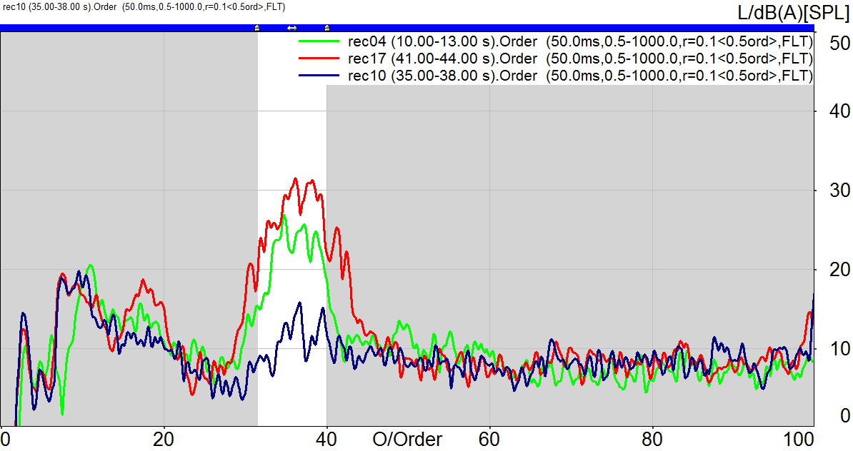
PSA BMPV Data
HW RPM | Power off | Power on, Cog cancel off | Power On Cog cancel on
30 | 36.6 | 41.9 | 25.4
45 | 47.2 | 46.9 | 33.1
60 | 31.4 | 31.0 | 35.5

Slide 6
Conclusions
1.) This analysis provides strong evidence that the noise is at 36th order.
2.) Cogging cancellation is having a significant impact on the SPL. At 30 and 45 HW RPM there is a decrease, but at 60 HW RPM the level increases.
3.) At 45 HW RPM cogging cancellation reduces the SPL level from 47 dBA to 33 dBA. To be commercially acceptable the level will have to decrease another 8 to 13 dB.

